Slide 1
Gradient Descent
LECTURE 16
Optimization methods to analytically and numerically minimize loss functions.
Sean Kang

Slide 2
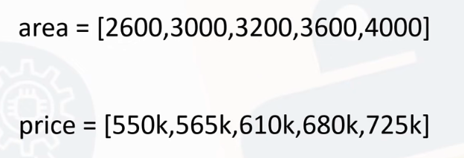
If we have data concerning housing sizes and their corresponding prices.
How do we create a model for this?
How do we derive some equation that looks like :
Price = b + m (Area)
( looks like y = b + mx). What is the value for b and m?

Slide 3
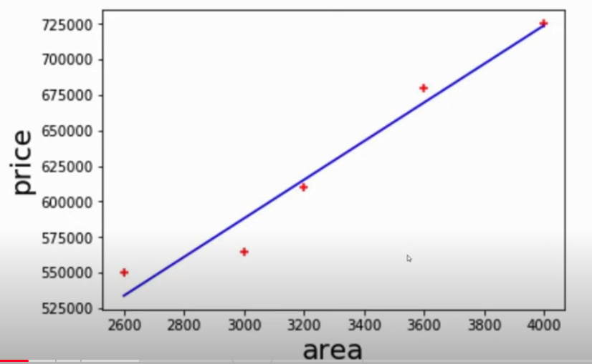
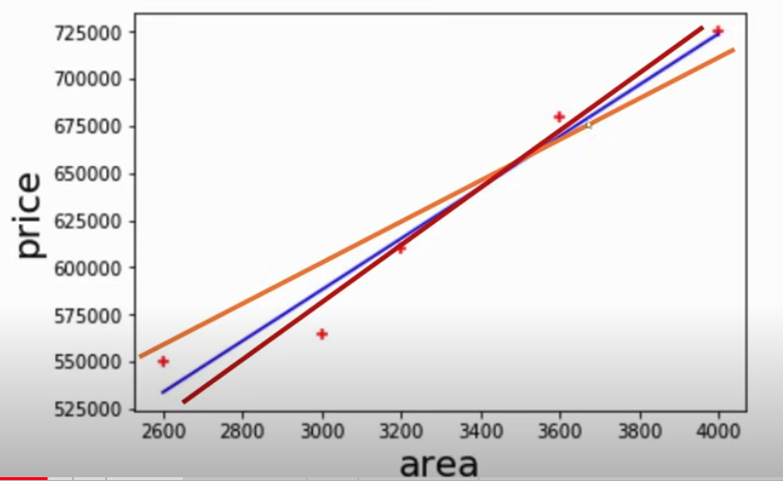
What is the best fit line?
Left: when there are few points, it might be easy to guess
When there are 1000, or 1mil points, then it is harder to create a better fit visually

Slide 4
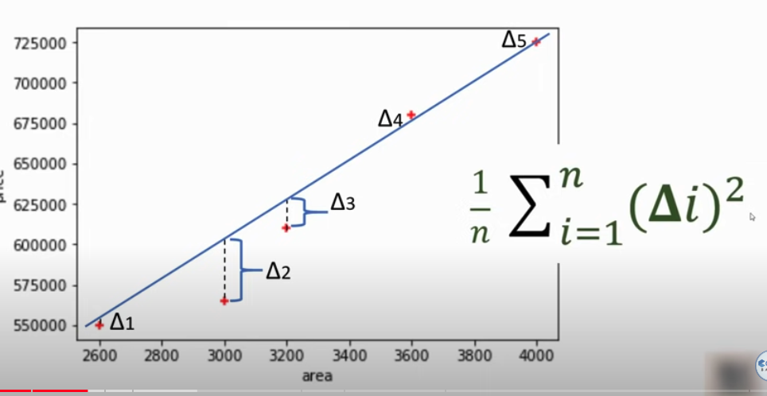
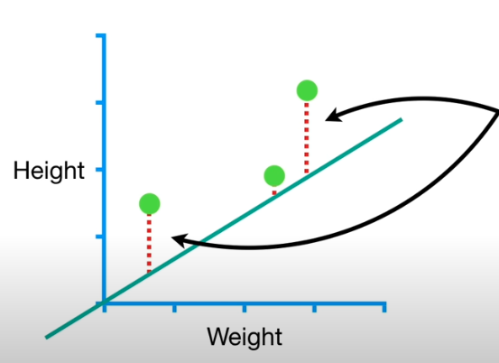
The approach
Draw some random line
Calculate the distance from actual y from the estimated y
Square the difference -- squaring amplify the difference and ignore + or – difference
Sum them up
Calculate the average
Another example of Height prediction from weight

Slide 5
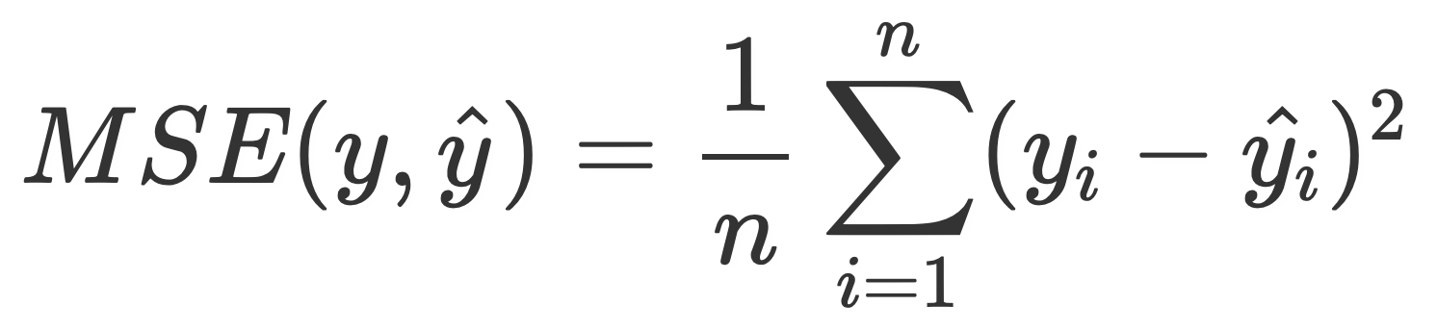
These differences is our COST function
This should look familiar from our Simple Linear Regression formula: MSE is Mean Square Error, our cost function

Slide 6
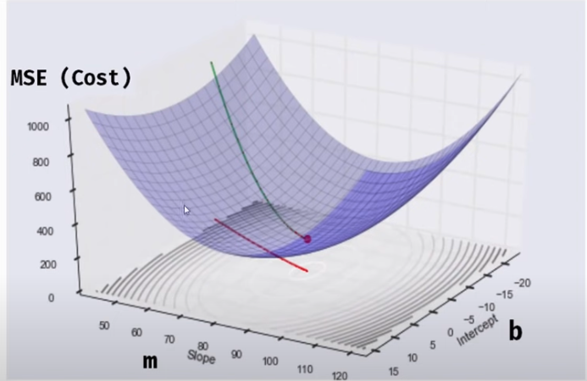

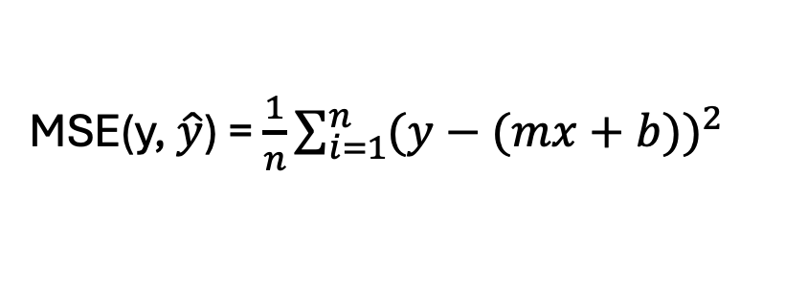
Looking at MSE and how to minimize it
$$\hat{\text{y}}\text{ = }\text{mx}\text{ +}\text{b}$$
MSE(y, $\hat{y}$) = $\frac{1}{n}\sum_{i=1}^{n}{{(y−(mx+b))}^{2}}$
Maybe we started here
And we want to go here at final optimal MSE
Start with m with zero, and b as zero
B is zero here
M = 0 here

Slide 7
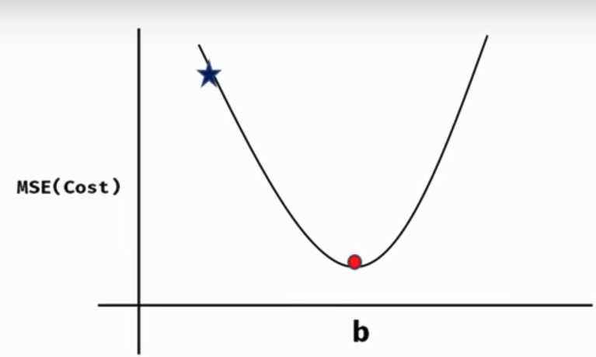
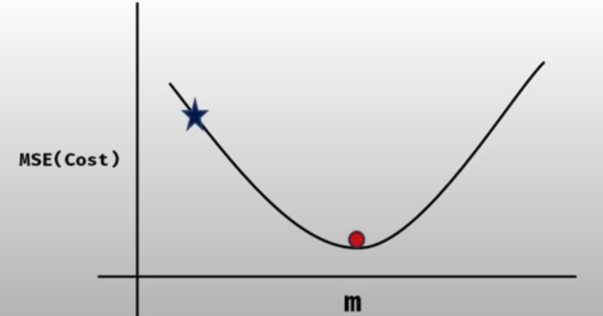
So, how to find that minimal MSE
These are the single dimensional view of the 3D plot
We don’t know where the minimal MSE for a given m or b so we need to figure out an efficient way to calculate it

Slide 8
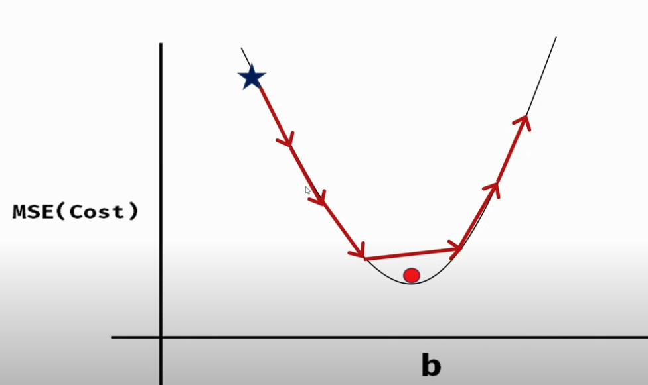
Incremental moving towards a smaller MSE
If we use fixed incremental sizes, we might miss the minimal MSE and realize MSE is increasing again

Slide 9
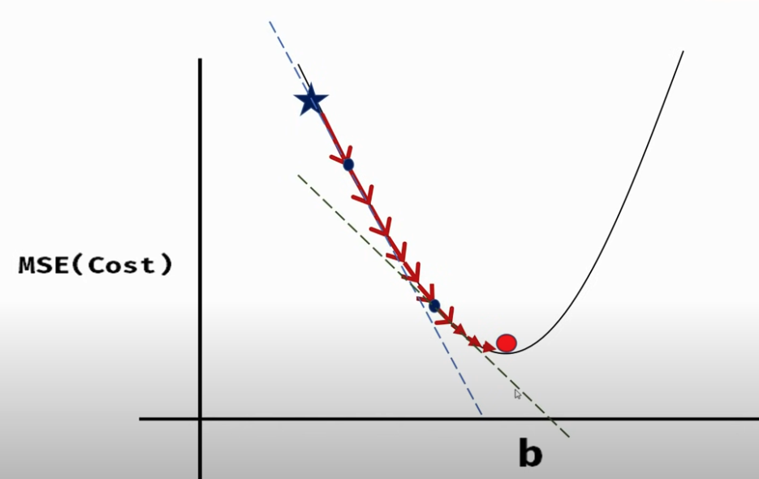
Finding that minimal MSE
This approach might work, where the incremental steps are smaller as the MSE reduces…
The slope is negative here
We can use derivative of MSE relative to b to see where the slope gets closer to zero.

Slide 10

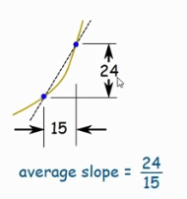
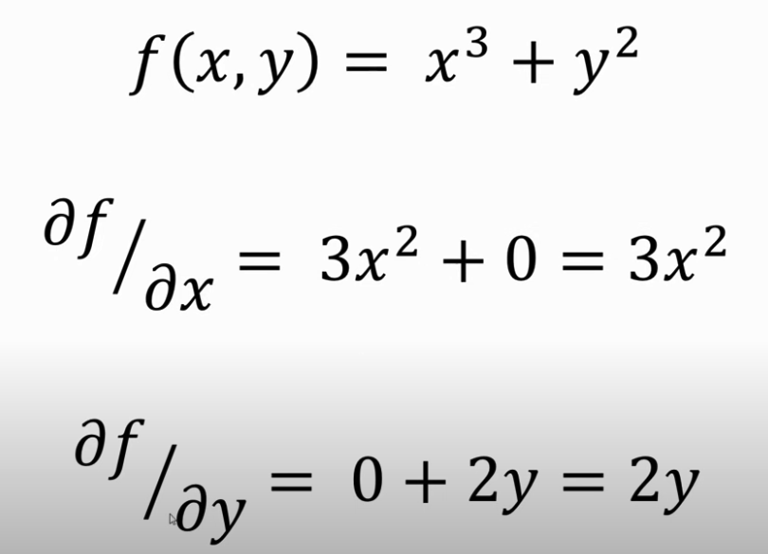
Detour into Derivatives and Partial Derivatives

Slide 11
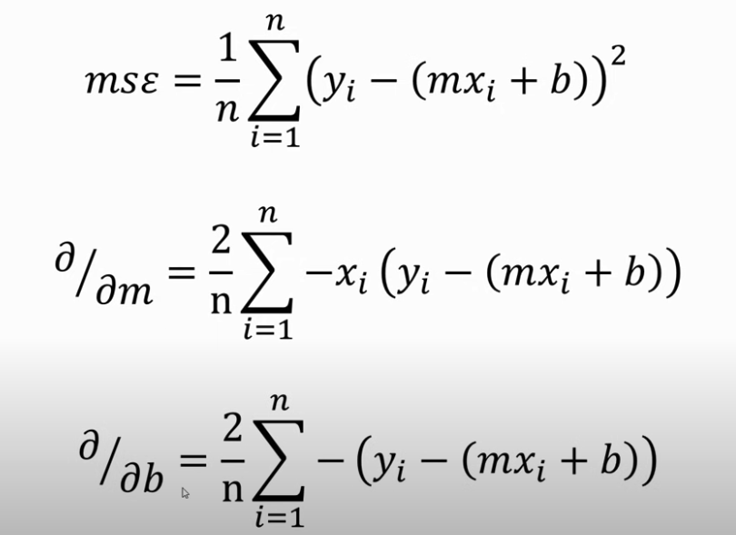
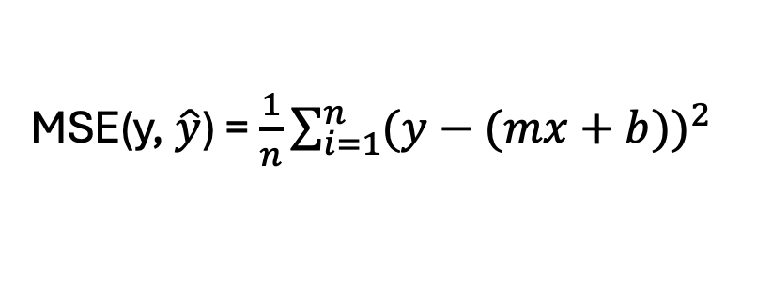
What is partial derivative of MSEs
MSE(y, $\hat{y}$) = $\frac{1}{n}\sum_{i=1}^{n}{{(y−(mx+b))}^{2}}$

Slide 12
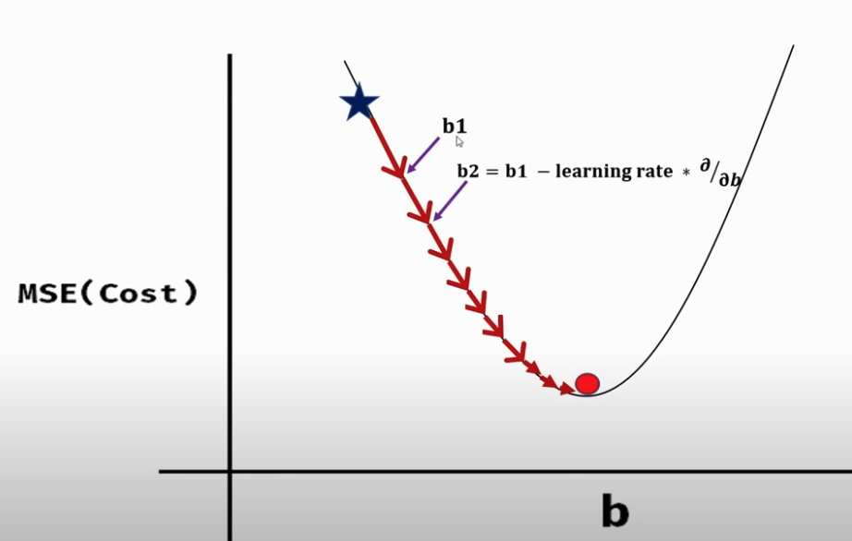
Using MSE and Derivatives to find our optimal b and m

Slide 13
Gradient Descent Algorithm
The gradient descent algorithm is shown below:
alpha is known as the “learning rate”.
Too large and algorithm fails to converge.
Too small and it takes too long to converge.

Slide 14
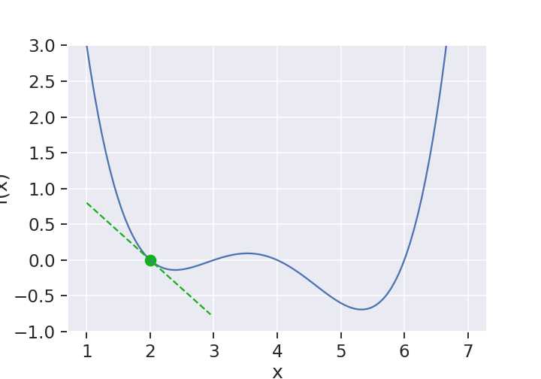
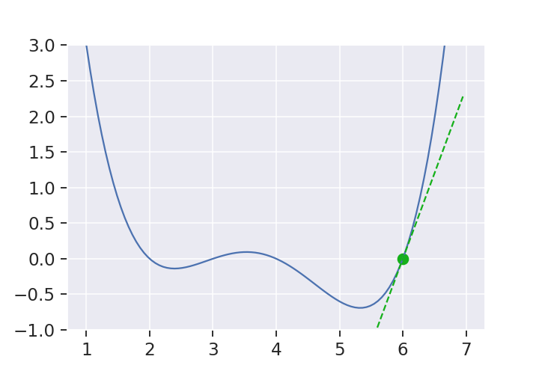
Gradient Descent Intuition
The intuition behind 1D gradient descent:
To the left of a minimum, derivative is negative (going down).
To the right of a minimum, derivative is positive (going up).
Derivative tells you where and how far to go.
f(x)
f(x)
x
x

Slide 15
Demo time

Slide 16
Summary of GD Approach
Step 1: Calc derivative of Loss Function (MSE) for each parameter (ML lingo : get the gradient of the loss function)
Step 2: Pick random values for the parameters
Step 3: Use parameters into the derivatives (aka gradient)
Step 4: Calc the step size
Step 5: Calculate new parameters
Step 6: Repeat at Step 3 or exceed the iterations

Slide 17
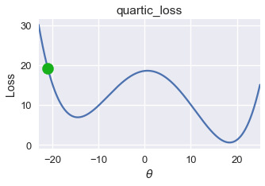
Simple Gradient Descent Approach Only Finds Local Minima
If loss function has multiple local minima, GD is not guaranteed to find global minimum.
Suppose we have this loss curve (not a convex function)

Slide 18
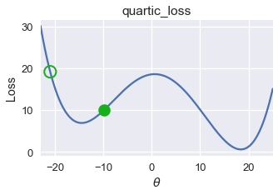
Gradient Descent Only Finds Local Minima
Here’s how GD runs
GD can converge at -15 when global minimum is 18 (this happens with quadratic functions, or non-linear functions)

Slide 19
Convexity
For a convex function f, any local minimum is also a global minimum.
gradient descent will always find the globally optimal minimizer.
For concave functions or non-linear functions, GD will find the first local minimum

Slide 20
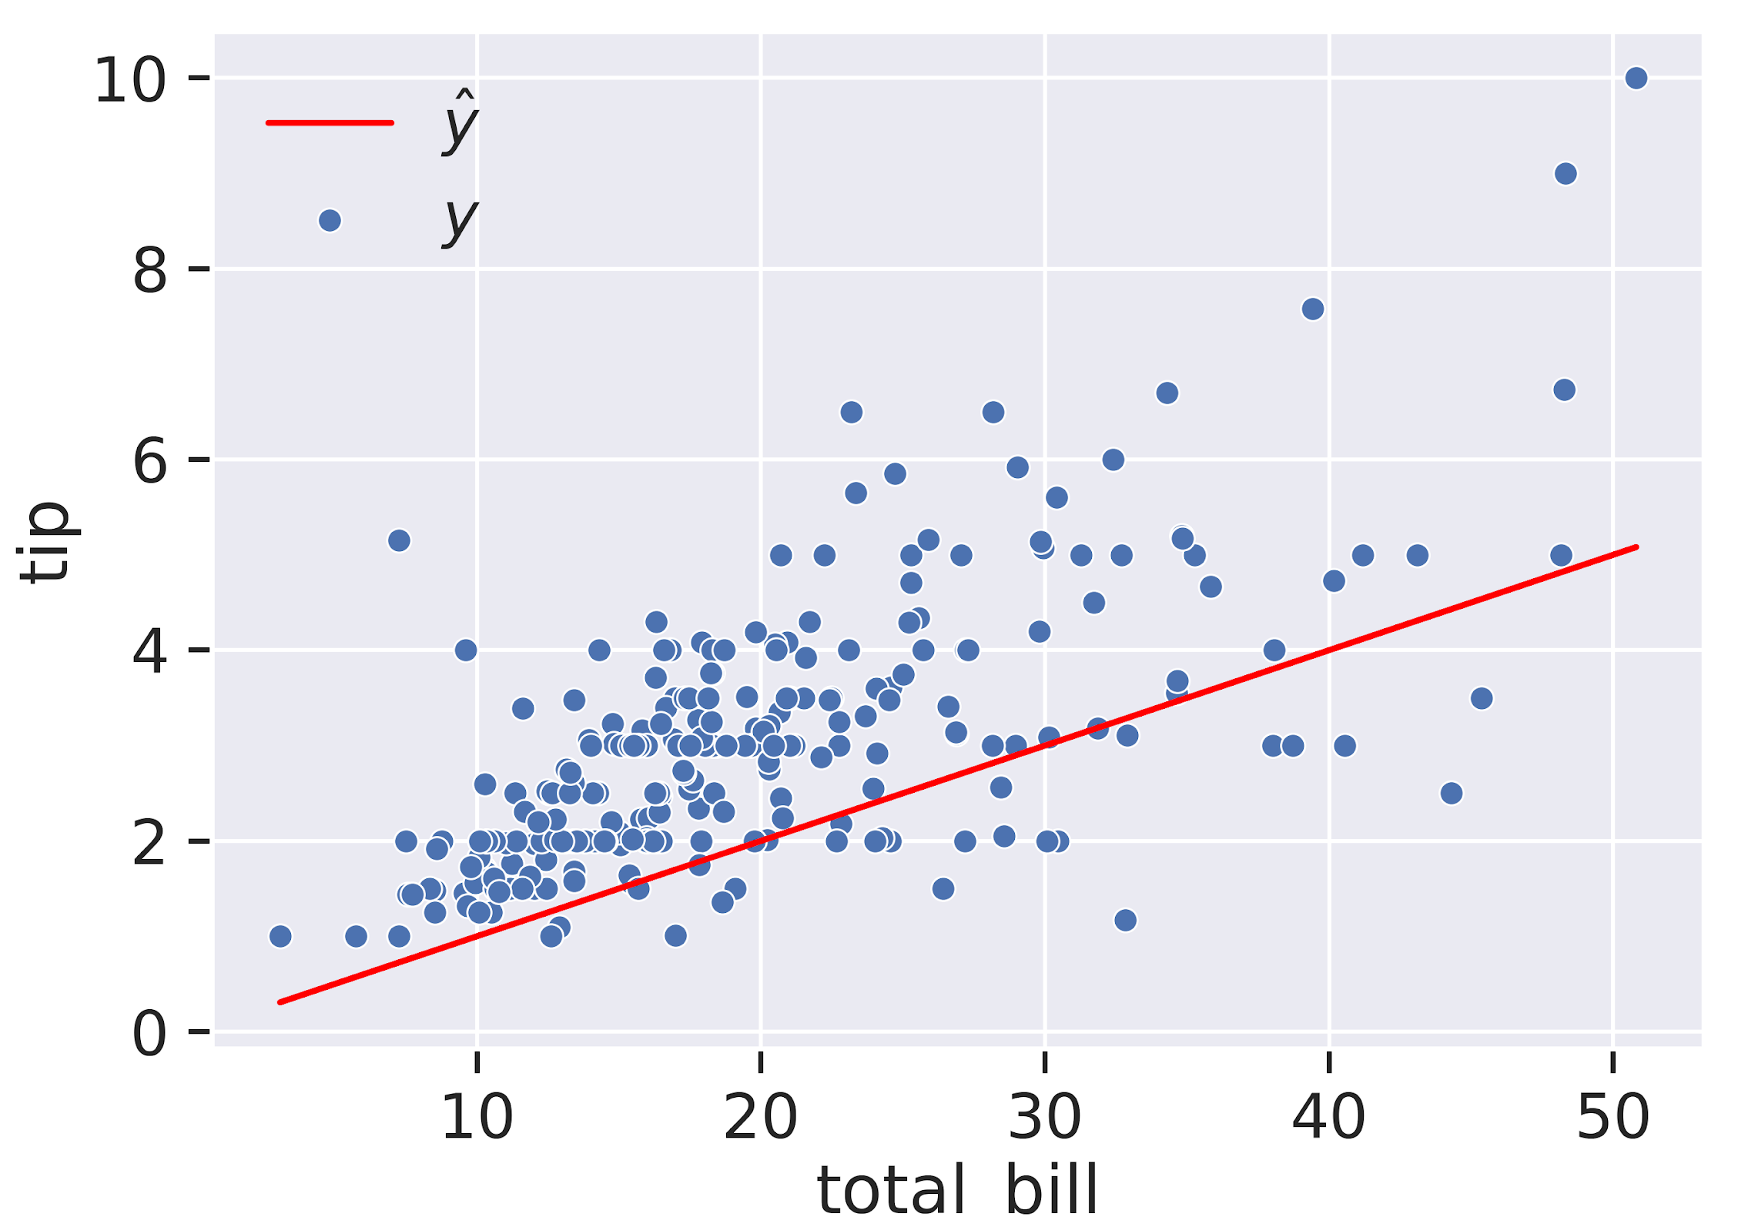

Optimization Goal
Suppose we want to create a model that predicts the tip given the total bill for a table at a restaurant.
For this problem, we’ll keep things simple and have only 1 parameter: gamma.
In other words, we are fitting a line with zero y-intercept.
See Notebook.

Slide 21
Stochastic Gradient Descent

Slide 22
Which Step in This Algorithm is Most Time Consuming?
Gradient Descent Algorithm
Calculating MSE at each iteration
Calculating the Derivatives at each iteration

Slide 23
Stochastic Gradient Descent
Draw a smaller simple random sample of data indices
Often called a batch or mini-batch
Choice of batch size trade-off gradient quality and speed
Think of the size of the Berkeley call for service data – compared to Los Angels, CA home sales records. https://maps.assessor.lacounty.gov/m/
Not easy to navigate that web
But the public free data exists

